Slide 1
CS 605 Group 7E - Client
Shayna Pedersen, Andrea Crowley,
Maggie Qian, Joann Zhang, Sagar Bansal

Slide 2
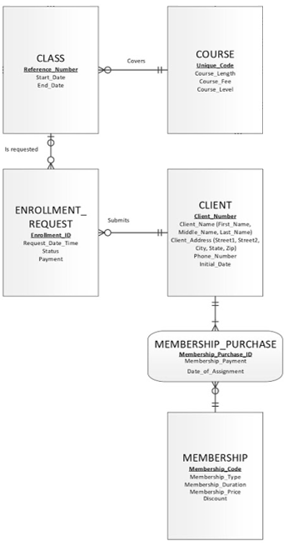
ERD

Slide 3
Q1: Who is the most valuable client?
CREATE VIEW Q1A AS
SELECT DISTINCT membership_purchase.client_number,
COUNT(membership_purchase_id) CountMemberships,
SUM(membership_payment) SumMembershipPmts
FROM membership_purchase
GROUP BY membership_purchase.client_number
ORDER BY membership_purchase.client_number;
CREATE VIEW Q1B AS
SELECT DISTINCT enrollment_request.client_number,
COUNT(reference_number) CoursesEnrolled,
SUM(payment) CoursePayment
FROM enrollment_request
WHERE enrollment_request.status = 'e'
GROUP BY enrollment_request.client_number
ORDER BY enrollment_request.client_number;
Notes:
We created 2 initial views to gather information about the clients’ membership purchases, including the count of how many memberships they have purchased, and a sum of the total revenue generated from the membership purchases; and the clients’ enrollment requests, including the count of how many classes they have enrolled in, and a sum of the total revenue generated from the class enrollments. This second view is limited to only where the client was enrolled in the class, since requesting a class but being waitlisted does not result in any payments.

Slide 4
Q1: Who is the most valuable client?
CREATE VIEW MOST_VALUABLE_CLIENT AS
SELECT DISTINCT
CLIENT.client_number "Client Number",
CLIENT.first_name "Client Name",
COALESCE(Q1A.countmemberships, 0) "Membership Count",
COALESCE(Q1A.summembershippmts, 0) "Total Membership Payments",
COALESCE(Q1B.coursesenrolled, 0) "Total Courses Enrolled",
COALESCE(Q1B.coursepayment, 0) "Total Enrollment Fees"
FROM CLIENT, Q1A, Q1B
WHERE
Q1A.client_number (+) = CLIENT.client_number AND
Q1B.client_number (+) = CLIENT.client_number
ORDER BY CLIENT.client_number;
Notes:
With the first two views created, we then combined the results into a third view, which was ultimately used to connect to Tableau. This view is structured by client, and combines the counts and sums of the membership purchases and enrollment requests. A left outer join was used to connect both the Q1A and Q1B views to the Client table, so that all clients would be included in the final view, regardless of whether they purchased any memberships or enrolled in any classes.

Slide 5
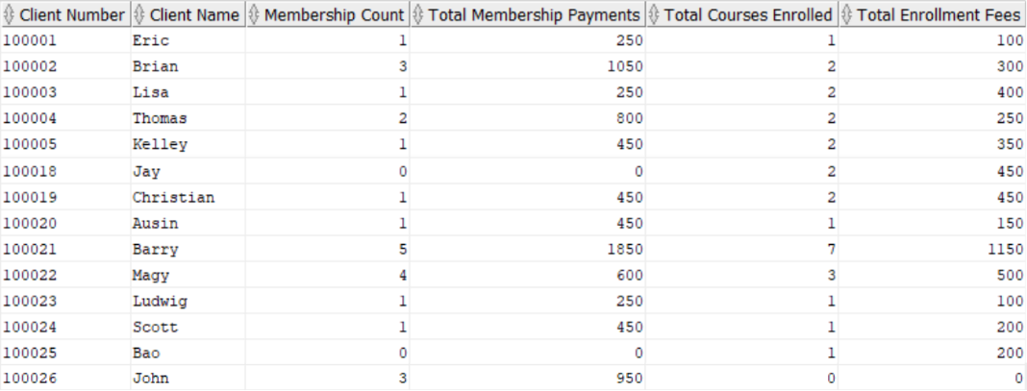
MOST_VALUABLE_CLIENT view
Please note that this is a partial representation of the view output
Notes:
This is the resulting data from the final view created, called MOST_VALUABLE_CLIENT.

Slide 6
Q2 : What membership type is related to the most profitable clients?
CREATE VIEW MembershipsForTopClients AS
SELECT
first_name AS "Client Name",
CLIENT.client_number AS "Client Number",
membership_code AS "Membership Category",
date_of_assignment AS "Membership Start Date",
date_of_assignment+365 AS "Membership End Date"
FROM CLIENT, MEMBERSHIP_PURCHASE
WHERE CLIENT.client_number = MEMBERSHIP_PURCHASE.client_number AND
CLIENT.client_number IN
(SELECT "Client Number" FROM MOST_VALUABLE_CLIENT
WHERE "Total Enrollment Fees" >
(SELECT AVG("Total Enrollment Fees") FROM MOST_VALUABLE_CLIENT))
ORDER BY CLIENT.client_number;
Notes:
Criteria for “profitable client” identification: Clients whose total enrollment fees > than average enrollment fees across all clients.
Leveraged MOST_VALUABLE_CLIENT View to identify profitable clients and used this to apply the selection criteria.
Selected Membership Purchase data for these clients - i.e., their membership history.

Slide 7
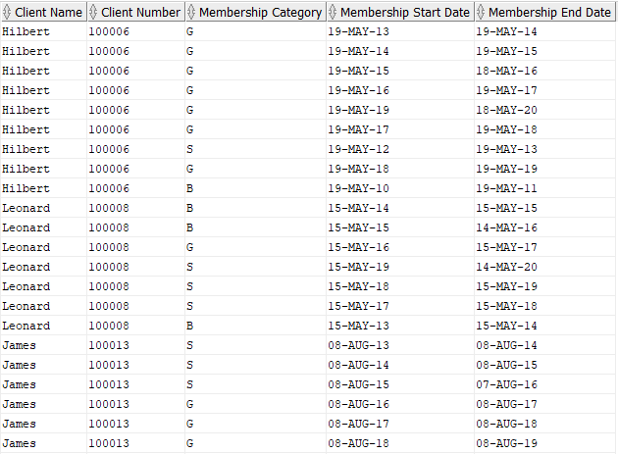
MembershipsForTopClients View
Please note that this is a partial representation of the view output

Slide 8
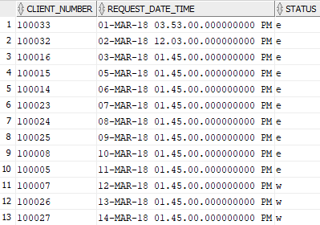
Q3: Is there a pattern in when people register for courses?
CREATE VIEW enrollmentpattern
AS
SELECT client_number, request_date_time, status
FROM enrollment_request;
Please note that this is a partial representation of the view output

Slide 9
Q4: Which course has the most waitlisted clients and should we offer more sections?
CREATE VIEW ques4_enroll_waitlst AS
SELECT course.unique_code,
course.course_level,
enrollment_request.request_date_time,
enrollment_request.status,
enrollment_request.payment,
COUNT(enrollment_request.client_number) client_Number
FROM class
JOIN course ON class.unique_code = course.unique_code
JOIN enrollment_request ON class.reference_number =
enrollment_request.reference_number
GROUP BY course.unique_code,
course.course_level,
enrollment_request.request_date_time,
enrollment_request.status,
enrollment_request.payment
ORDER BY enrollment_request.status, COUNT(enrollment_request.client_number) DESC;

Slide 10
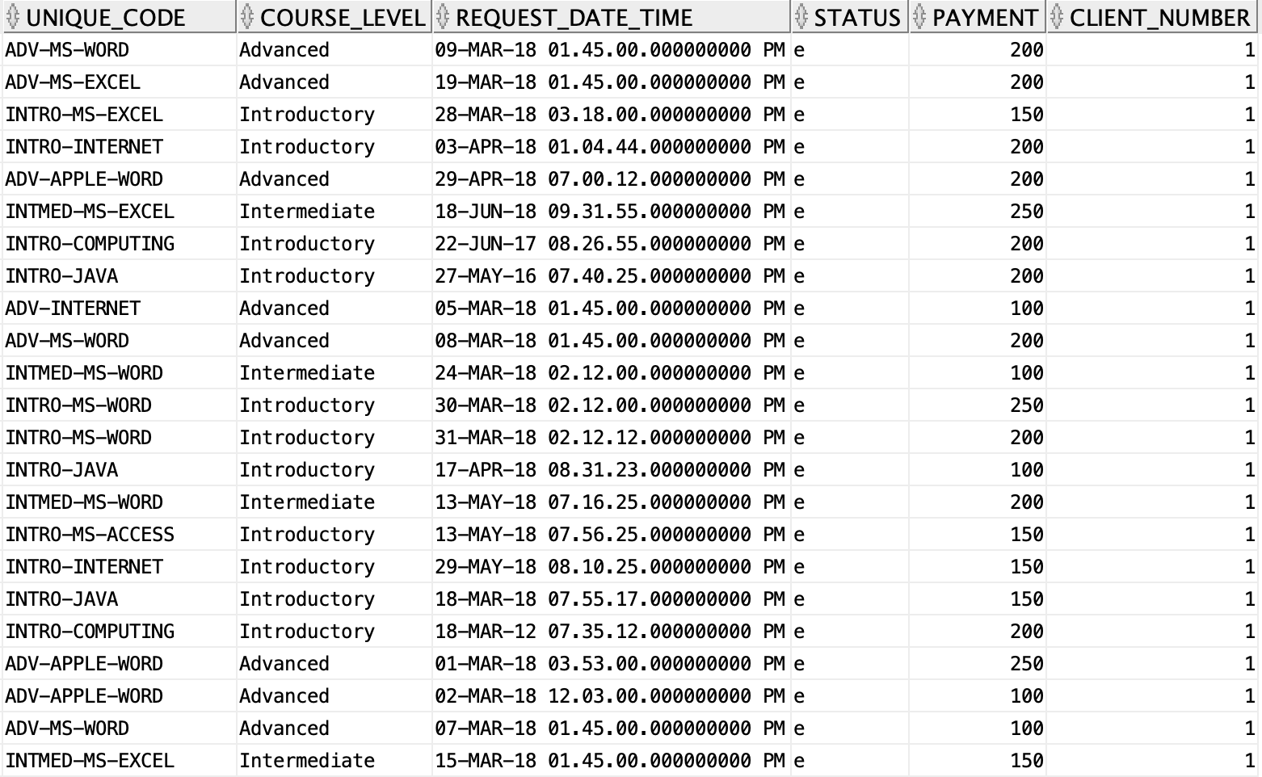
Ques4_enroll_waitlst View
Please note that this is a partial representation of the view output

Slide 11
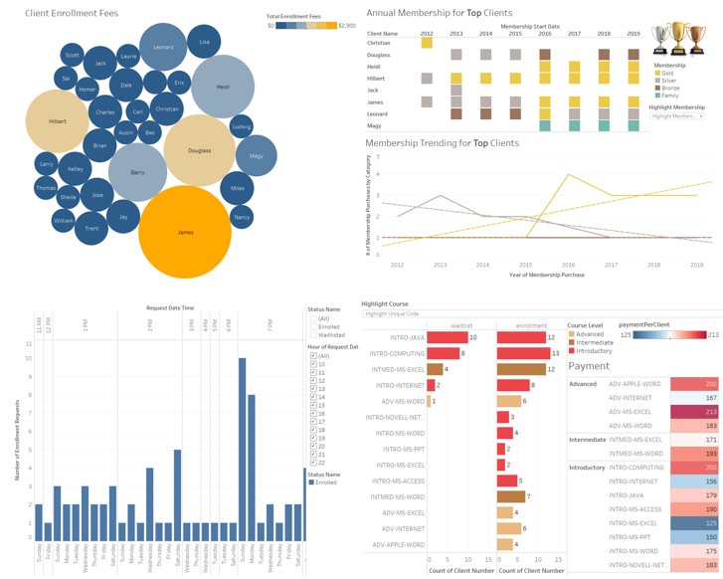
Our Tableau Storyboard
Notes:
https://public.tableau.com/views/Phase3-ClientSegment-Team7E/Phase3-ClientSegment-Team7E?:display_count=y&publish=yes&:origin=viz_share_link

Slide 12
Our Suggestions
Recognize Valuable Clients to Conduct Targeted Marketing and Increase Sales: Management should recognize their most valuable clients with discounts based on enrollment frequency or years of membership to encourage all clients to enroll in more classes and renew their memberships.
Drive Value through Promoting Membership Upgrades: Management should leverage membership data to drive value creation for top clients who currently purchase lower tier memberships (e.g., silver, bronze). Management should demonstrate the opportunity for clients to realize enrollment fee savings with membership upgrades. Upgrades may impact enrollment revenue in the short-term, but will enhance long-term client retention.
Adjust Registration Time and Provide More Registration Support: Management should open up the registration time in March, especially on Sundays around 7 pm. Do more promotions for the second highest period which is Monday at 7 pm so that people register more in advance. Management should also allocate more customer service representatives during these two periods to support registration needs.
Add New Sections to Meet the Demand and Drive Sales: Management should add more sections for the two courses, intro-level JAVA and COMPUTING, to meet the demand and boost sales revenue, and take a further look at the demand of intermediate-EXCEL course to see whether there’s need to offer more sections.

Slide 13
Thank you!
Any Questions?

